Slide 1


Slide 2



Slide 6


Slide 8








Slide 9
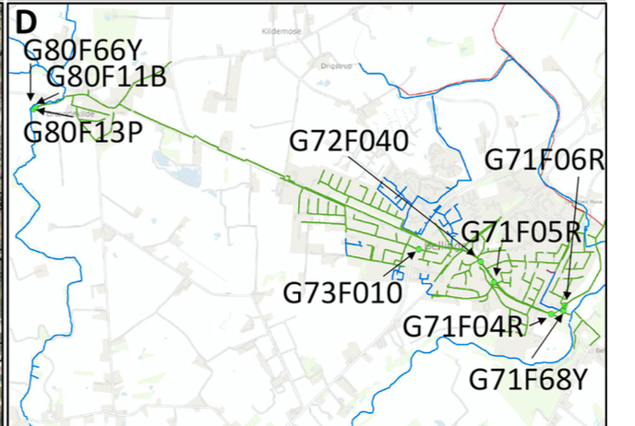
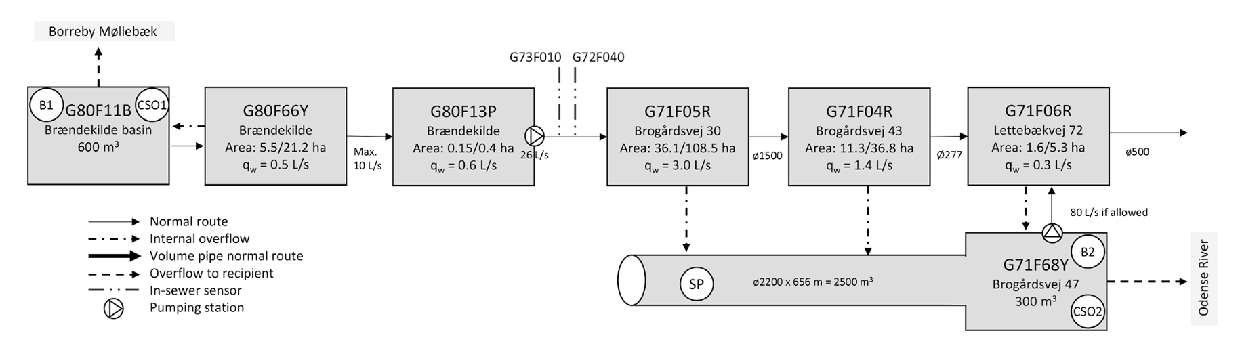
Raingauges
Brændekilde

Slide 10
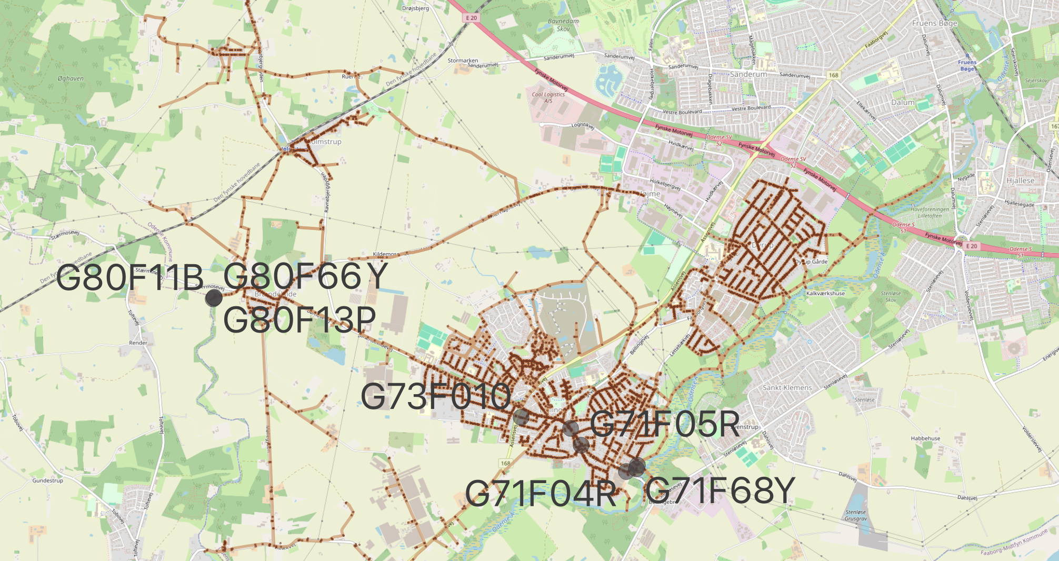
Brændekilde
G80F11B
G80F66Y
G80F13P
Dyrup
5427
Brændekilde
G72F040
G73F010
5425
Bellinge
Bellinge
G71F05R
G71F04R
G71F06R
G71F68Y

Slide 11


Cross-sectional view
Structure 2
Inlet Level
Basin Level
Overflow
Pump Sump
Level
Structure 1
Pipe
Position
Pipe
Level
Flow
Sensors
Power

Slide 12
root
single_series
combined_data
sewer_data
rain_gague_data
raw
clean
G80F11B_Level1
5425
5425
raw
clean
Data
Timestamps
Columns
bools
.
.
.

Slide 13
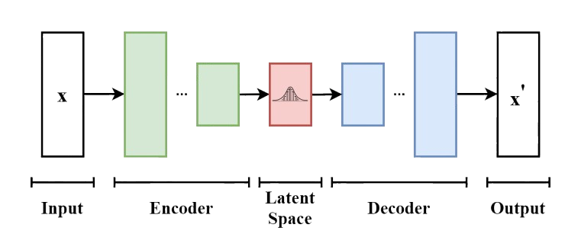
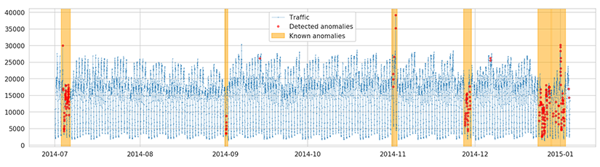

TRAIN
ANOMALIES
MASK
IMPUTE

Slide 14
Diagnostics
Detection
Prognosis

Slide 15
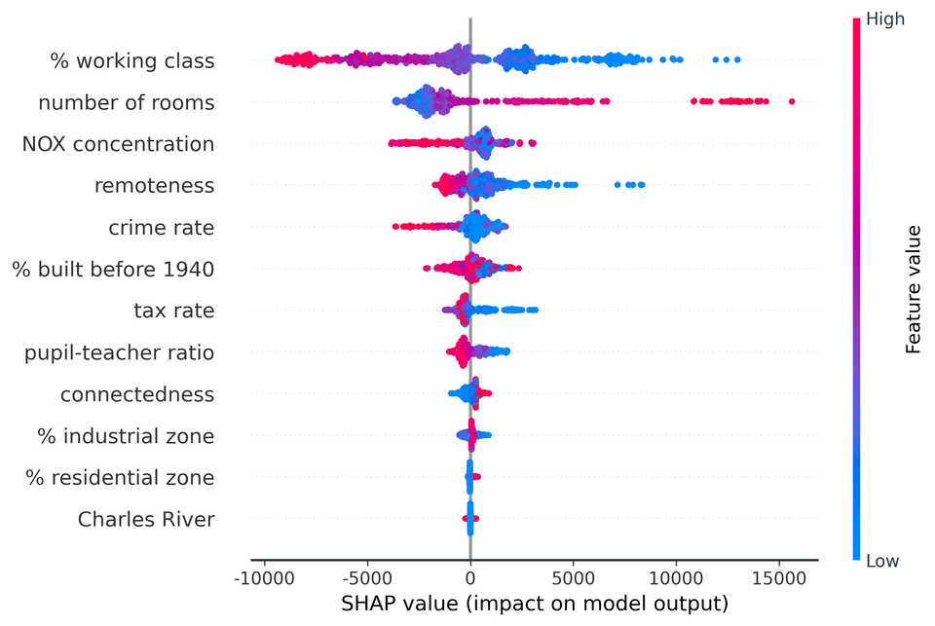
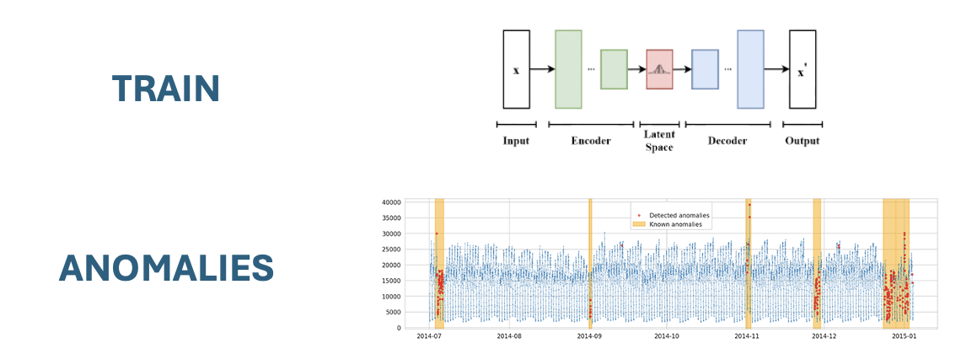
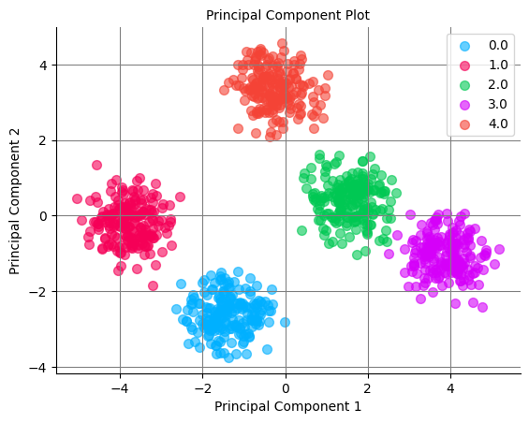
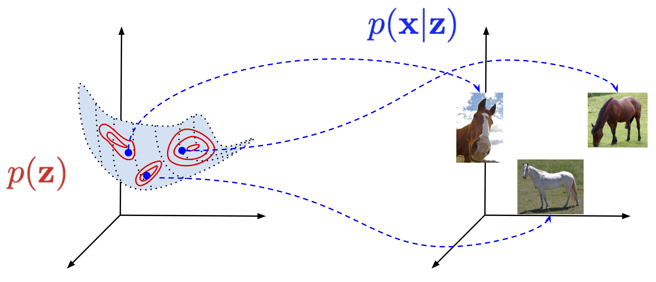
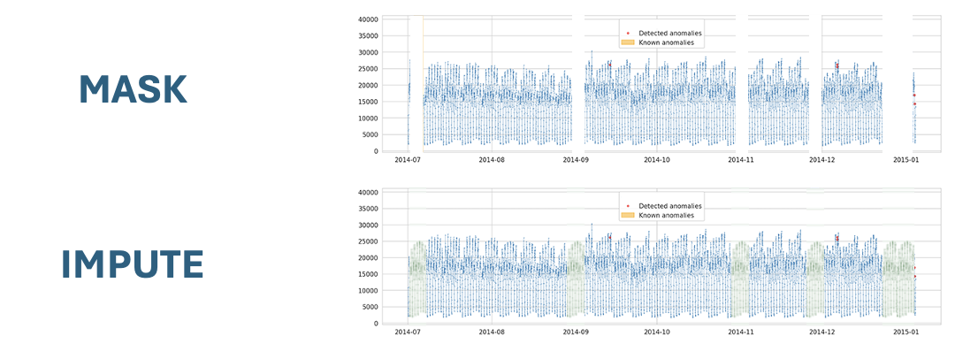
Detect
Diagnose
Prognose

Slide 16
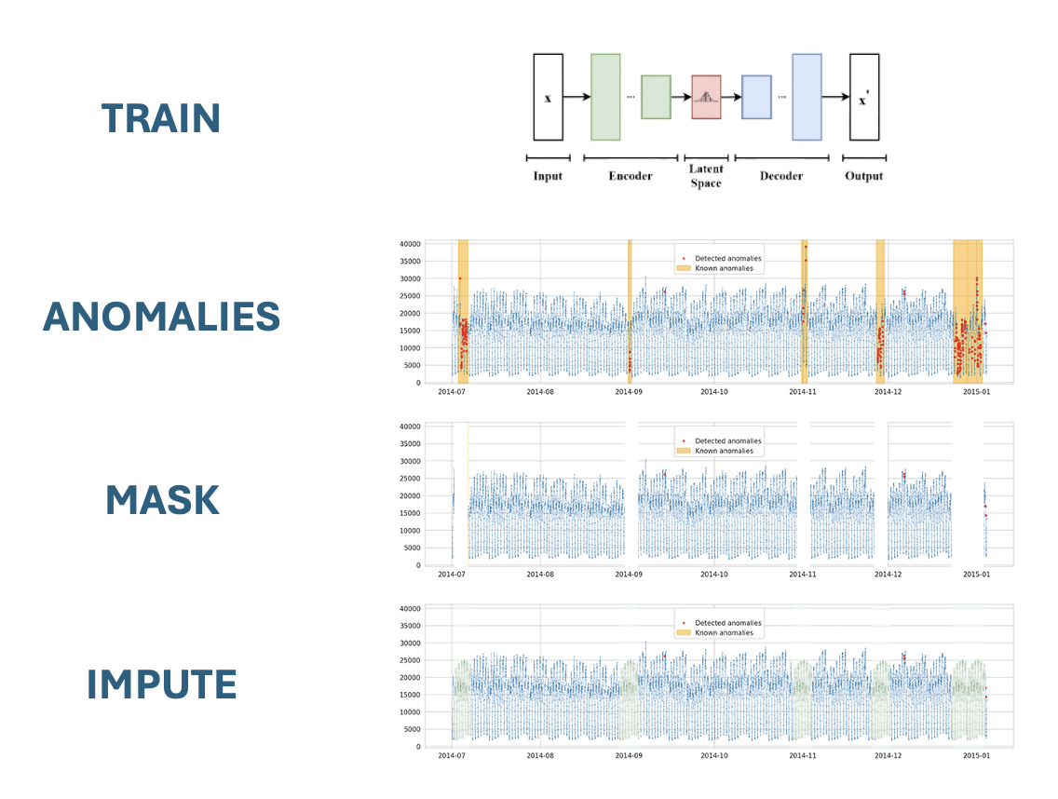


Slide 17
Multiple
SCOPE
Single
Short-term
Long-term
TEMPORAL

Slide 18
Faults
Synthetic
Blockage
Delayed
Blockage
Debris
Corrosion
Step
Response
Step
Drift
Multiple
Multiple
SCOPE
SCOPE
Frozen
Spikes
Noise
Calibration
Baseline shift
Drift
Aging
Frozen
Pulse
Noise
Step
Drift
Response
Single
Single
Short-term
Long-term
Short-term
Long-term
TEMPORAL
TEMPORAL
Notes:
Signal loss?
Pulse?

Slide 19
Origin
Impact
System
Non-critical
Critical
Multi sensors
SCOPE
Technical
Single sensor
Short-term
Long-term
Short-term
Long-term
TEMPORAL
Notes:
Signal loss?
Pulse?

Slide 20
Faults
Origin
Impact
Blockage
Connection
Blockage
Debris
Corrosion
Burst
System
Temporary
Critical
Multi sensor
SCOPE
Frozen
Spikes
Noise
Calibration
Baseline shift
Drift
Aging
Technical
Single sensor
Short-term
Long-term
Short-term
Long-term
Short-term
Long-term
TEMPORAL
Notes:
Signal loss?
Pulse?

Slide 21
Definitions
Mutliple sensor faults
Temporal overlap; within 1-2 minutes
And spatial proximity; same structure
Pattern consistency; correlation?
Long term faults
If the errors persists for more than 1 hour
Limitations
We’ll not focus on:
Multiple occurances of the same error within a time frame
Different types of errors occuring within the same time frame
Notes:
How to define

Slide 22
Evaluation
Single sensor Time series detection | Multiple sensors Binary detection | Long term Binary detection
For each error type: Precision & Recall ROC by threshold Binary event detection And combined | Accuracy Confusion matrix | Accuracy Confusion matrix
Notes:
How to define

Slide 23
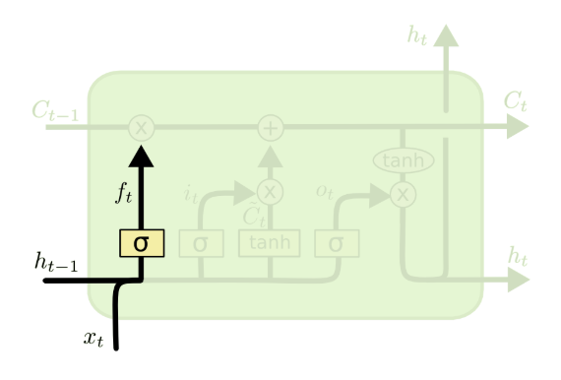
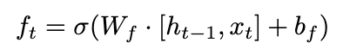
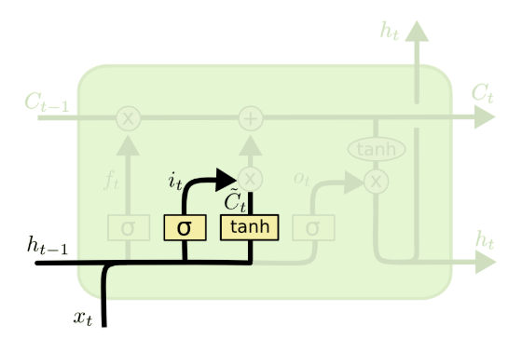
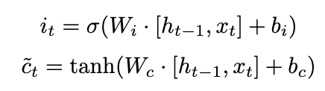
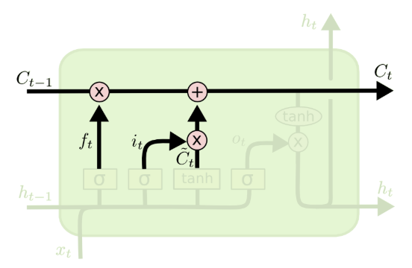
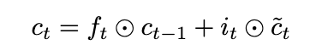
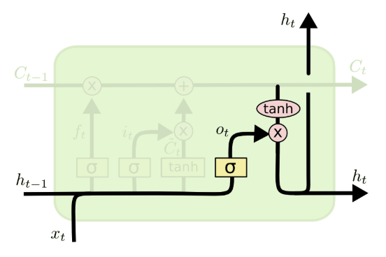
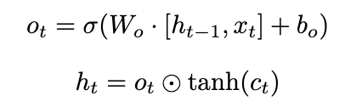
Forget Gate
Input Gate
Candidate Cell State
Cell State Update
Cell State
Hidden State

Slide 24
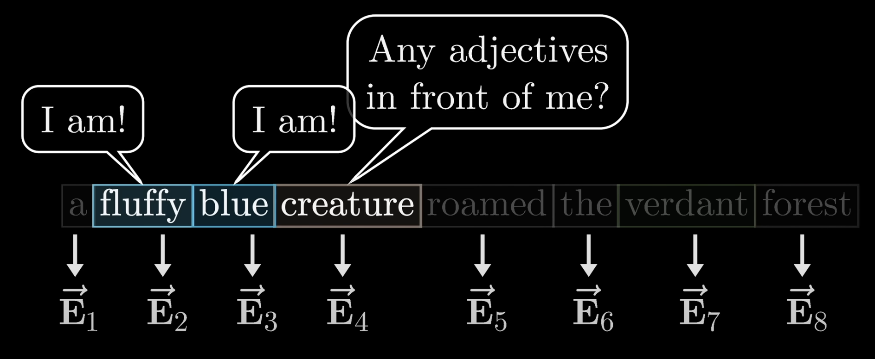

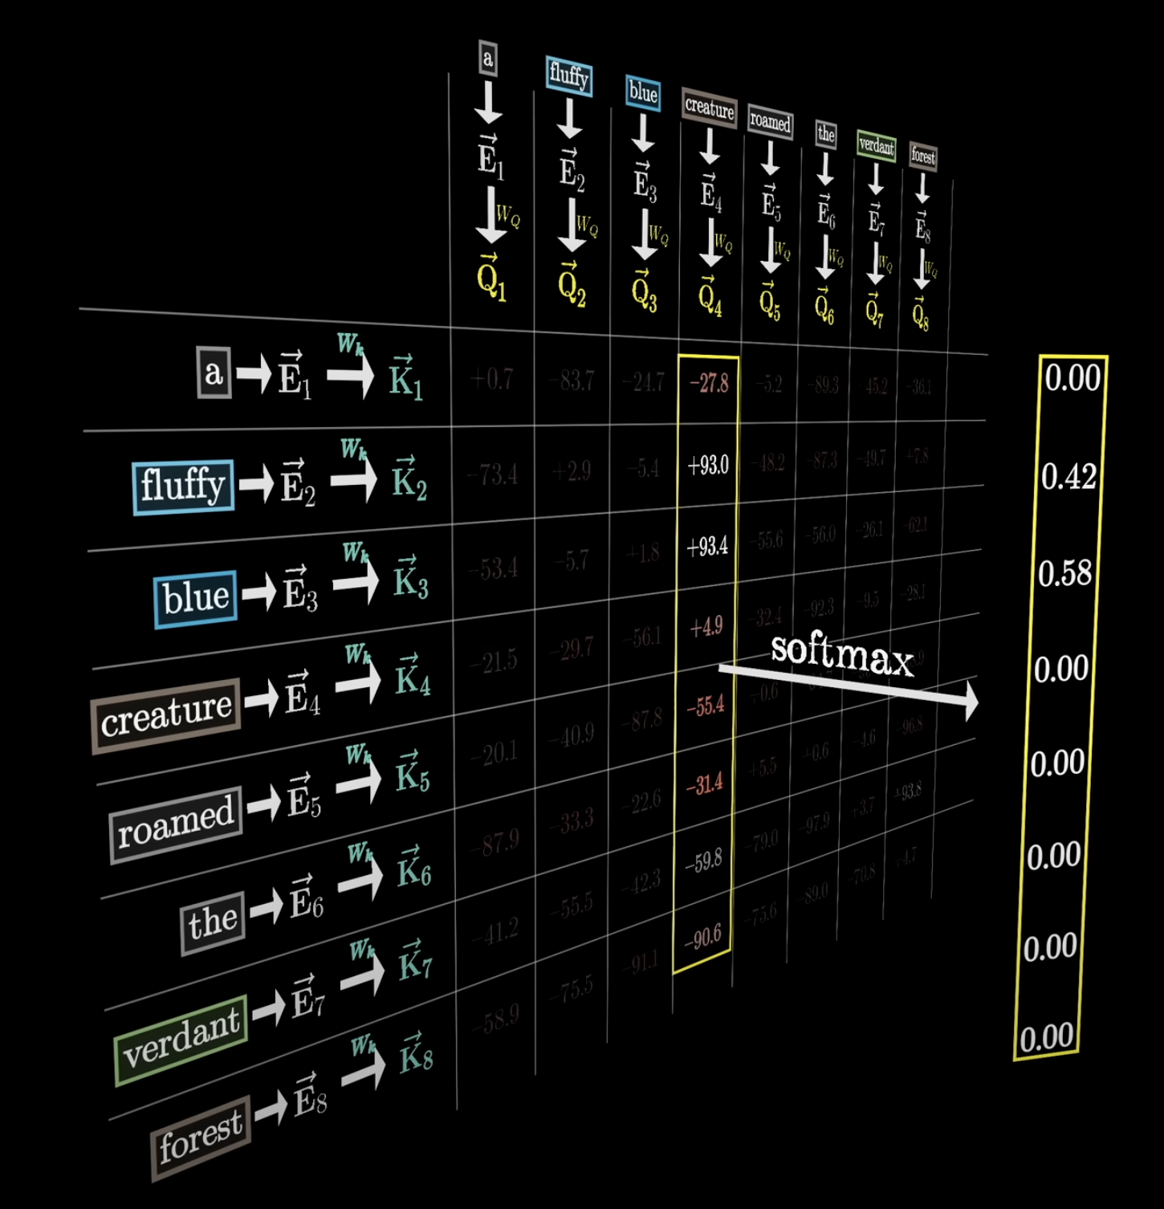
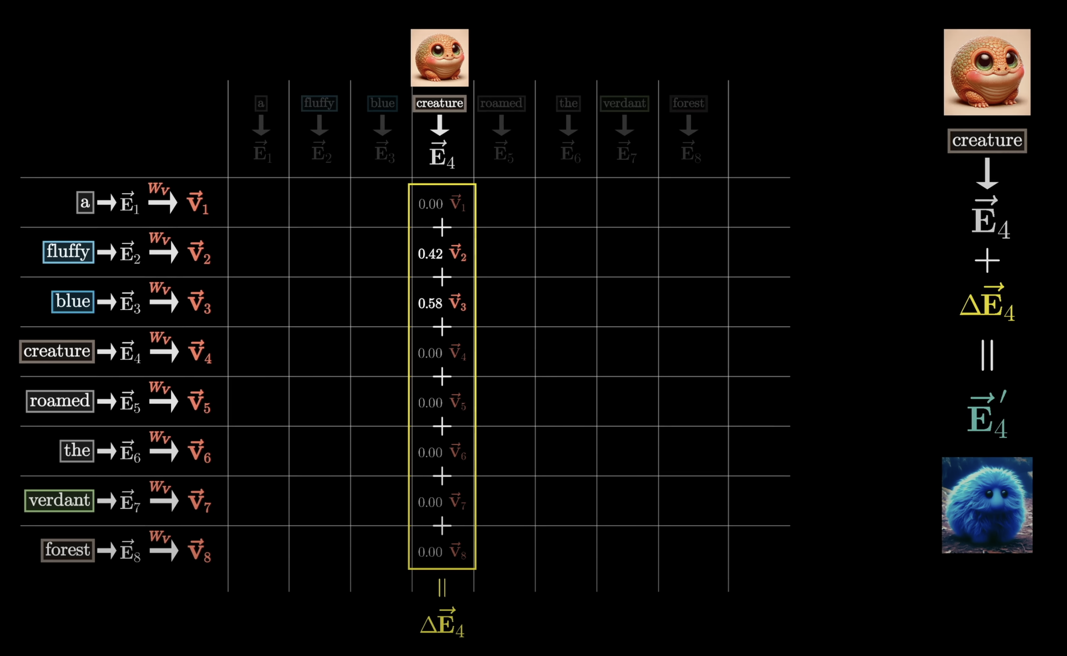
Q₄
K₂
K₃
Dot-Product
Update the embedding of
Vector Sum

Slide 25

Q₄
Query
and
Keys
K₂
K₃
Queries
Embedding Vectors
Dot-Product
Keys
Attention Weights
Update Embedding
of E₄
Proposed Change
Values
~Hidden State
Sum of
Vectors

Slide 26
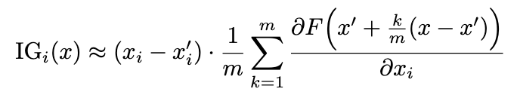
MODEL
Prediction
Gradients
Baseline of zero-vectors
x’
Linear Interpolation
m steps
Aggregate
ẟF/ẟx_{i}
· · ·
· · ·
MODEL
Gradients
Prediction
Input data
x
Integrated Gradients

Slide 27
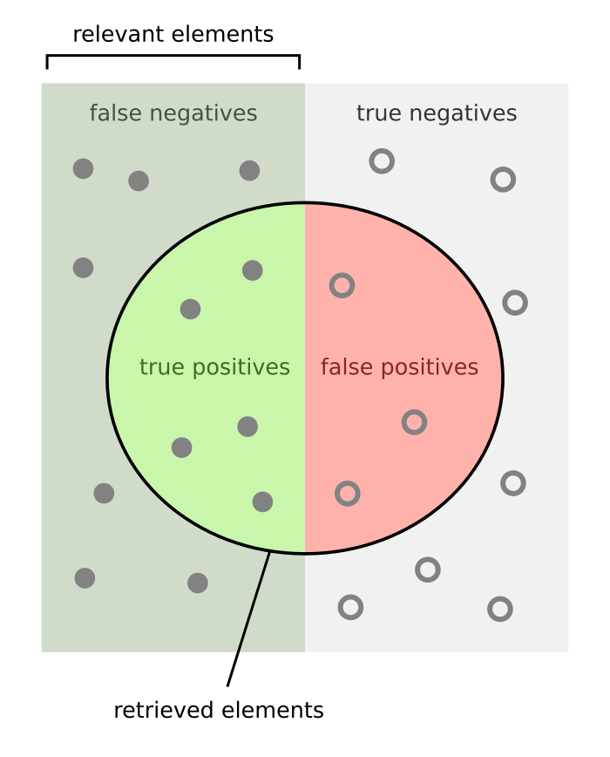
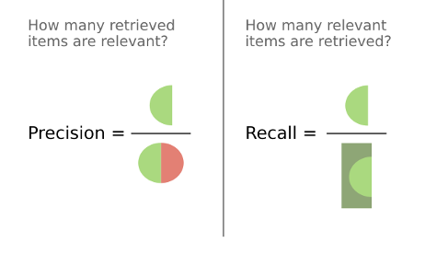

Slide 28
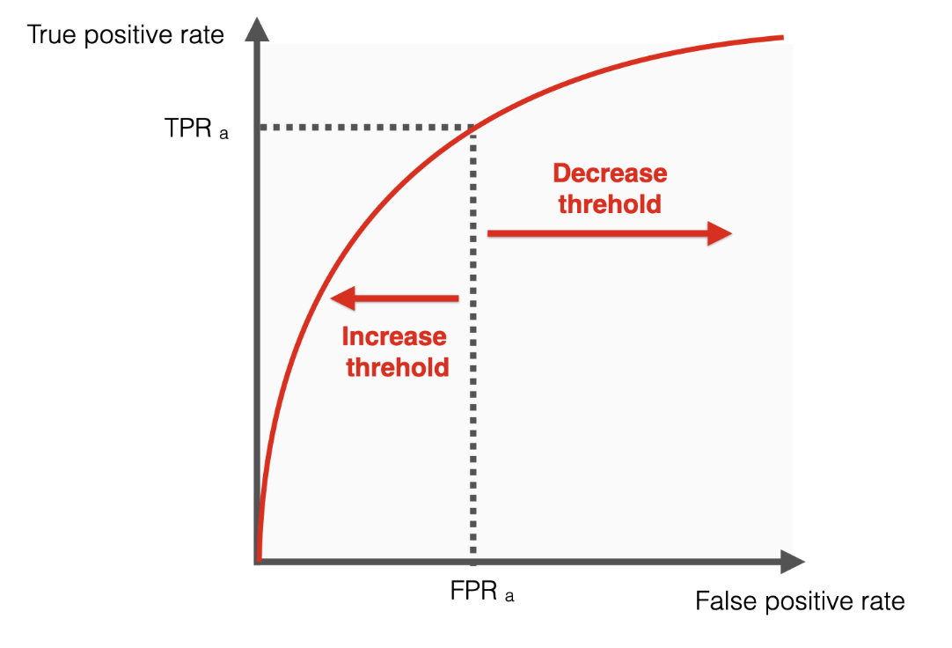
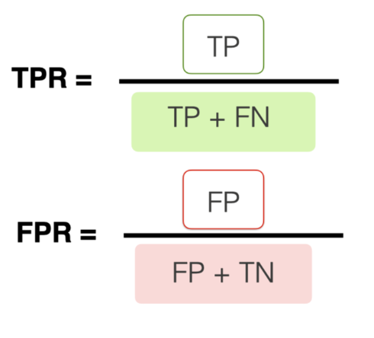
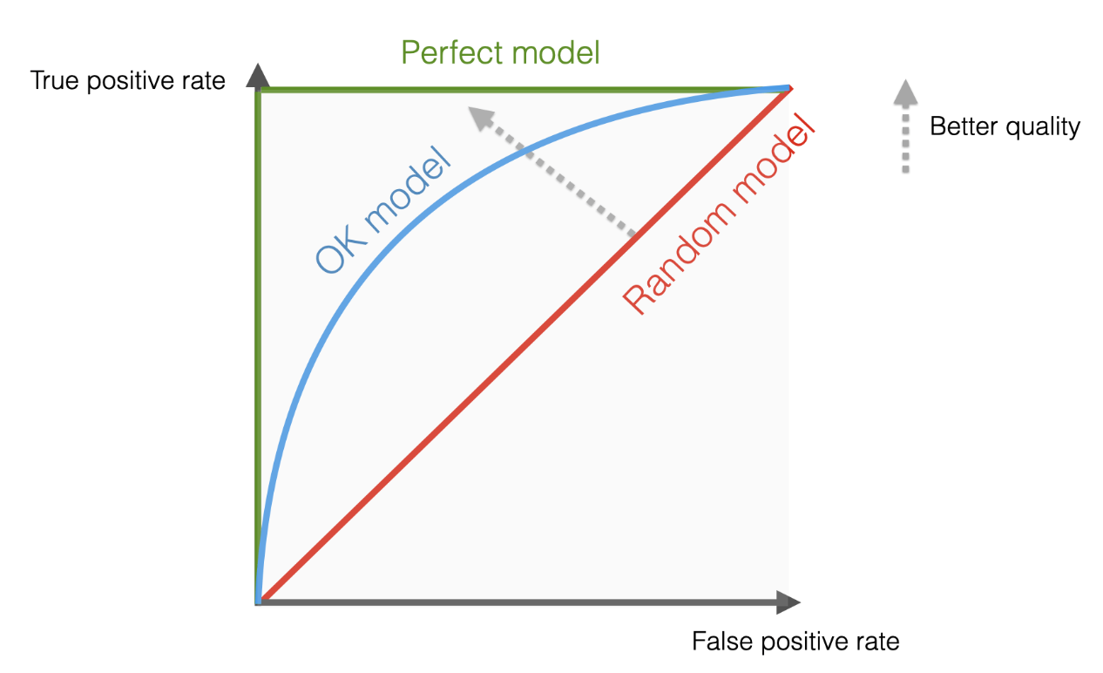
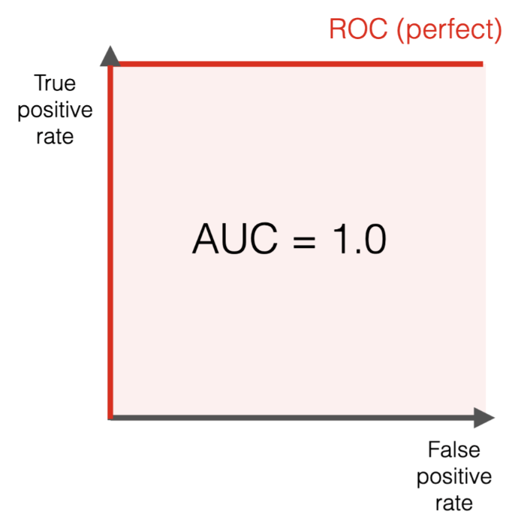
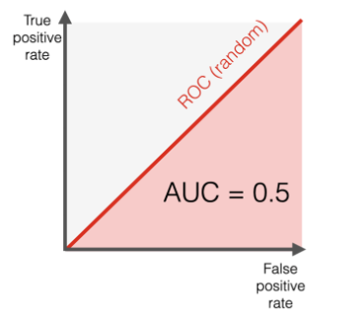

Slide 29
MODELLING
ANOMALY
DETECTION
REFINEMENT
Benchmark
Optimize
Indicators
Evaluate
Iterative

Slide 30
OPTIMAL
MODELLING
EFFECTIVE
ANOMALY DETECTION
REFINED
MODELLING
&
DETECTION

Slide 31
Precipitation
MODEL
Prediction
Sensor
Target
120 minutes
1 minute ahead

Slide 32






1
Complexity
2
Features
3
Parameters
4
Modelling
5
Priorities
6
Final

Slide 33



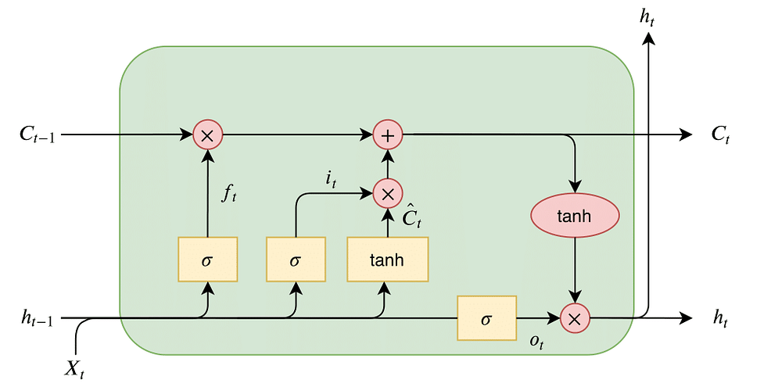

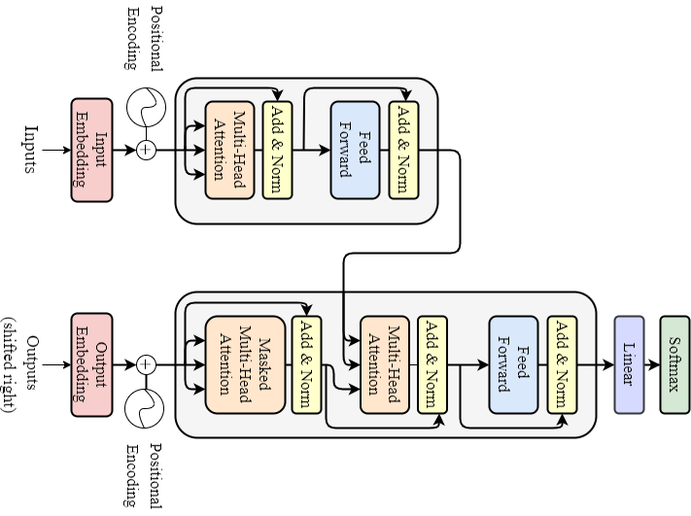
Benchmarking
Lag 1 Predictor
Linear Regression
LSTM
Transformer

Slide 34
Transformer
LSTM
Linear Regression
Lag 1 Predictor
Benchmarking

Slide 35
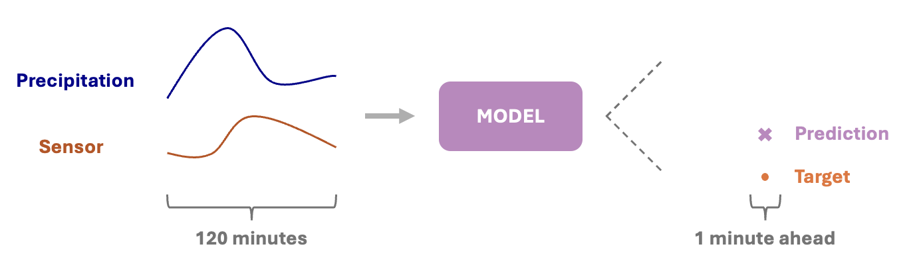
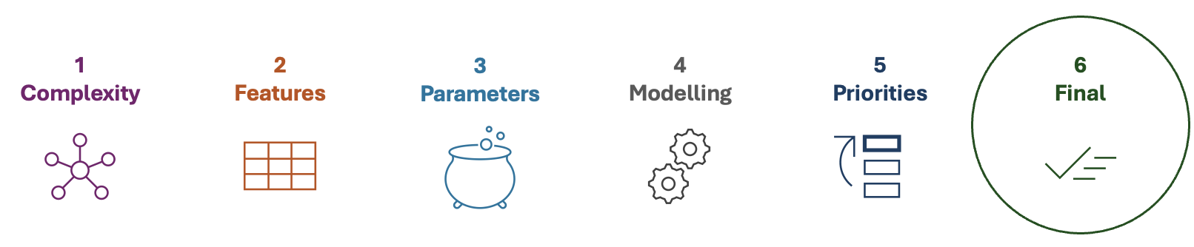
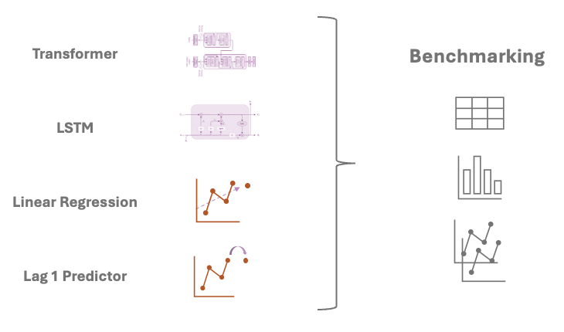
1. Data Preparation
2. Transformer Optimization
3. Benchmarking

Slide 36
Precipitation
Anomalies
POLLUTE
Sensor
Input
Target
Input
Target

Slide 37

Hidden State
MODEL
Target
Residual
Prediction
MODEL
Integrated Gradients

Slide 38
Hidden State
MODEL
Target
Residual
Prediction
MODEL
Integrated Gradients

Slide 39




Target
· · ·
Anomalous
Hidden State
Isolation Forest
or
Residual
Normal
Integrated Gradients
· · ·

Slide 40
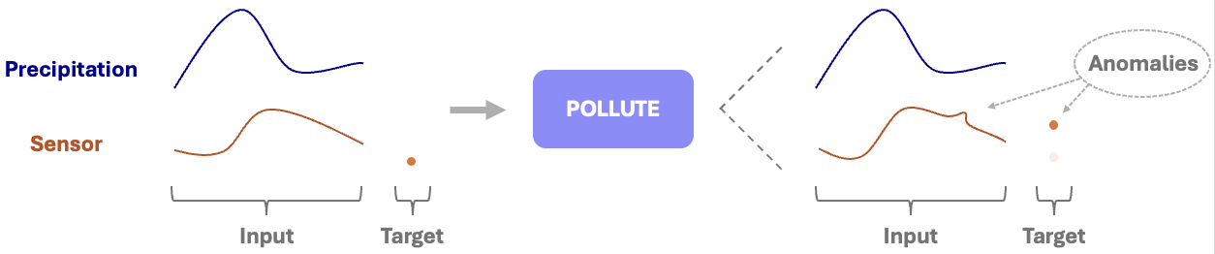
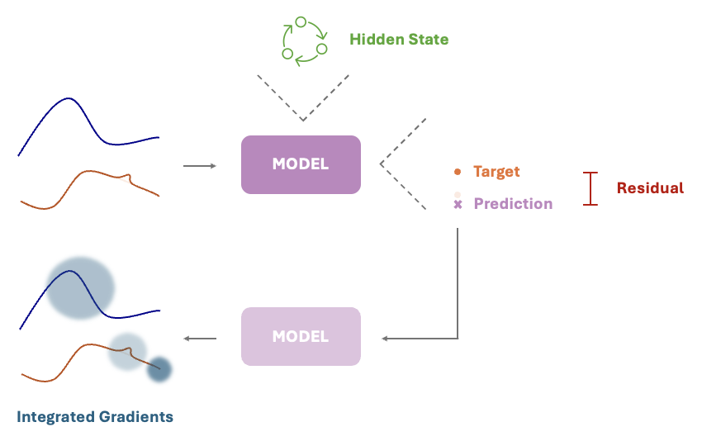
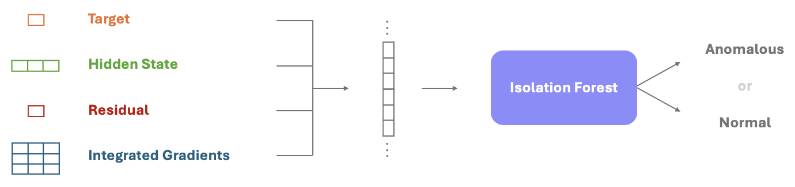
1. Pollute dataset
2. Extract Features
3. Anomaly Detection

Slide 41
Polluted Dataset
Split
Training Set
Validation Set
Test Set
Fit Model
Extract Indicators
Anomaly Detection
Normal
Anomalous

Slide 42
Polluted Dataset
Split
Training Set
Validation Set
Test Set
Anomaly Detection
Normal
Anomalous

Slide 43
Training Set
Validation Set
Test Set
Fit Model
Extract Indicators
Anomaly Detection
Normal
Anomalous

Slide 45
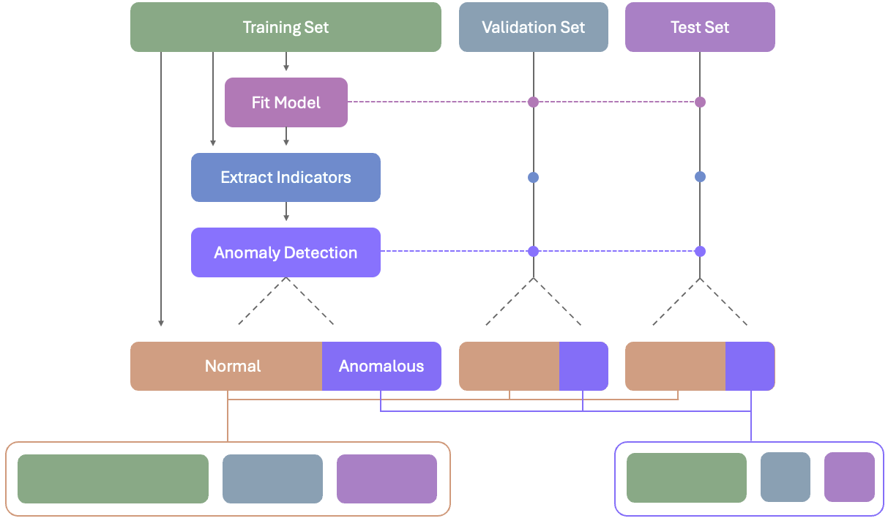
Iteration 0
Comparison
Fine-Tune Model
Fine-Tune Model
Combined
Indicators
Iteration 1
Extract Indicators
Extract Indicators
Anomaly
Detection
· · ·
· · ·
· · ·

Slide 46
Training Set
Validation Set
Test Set
ANOMALY DETECTION
Normal
Anomalous
· · ·
· · ·
· · ·
· · ·
· · ·
· · ·

Slide 47
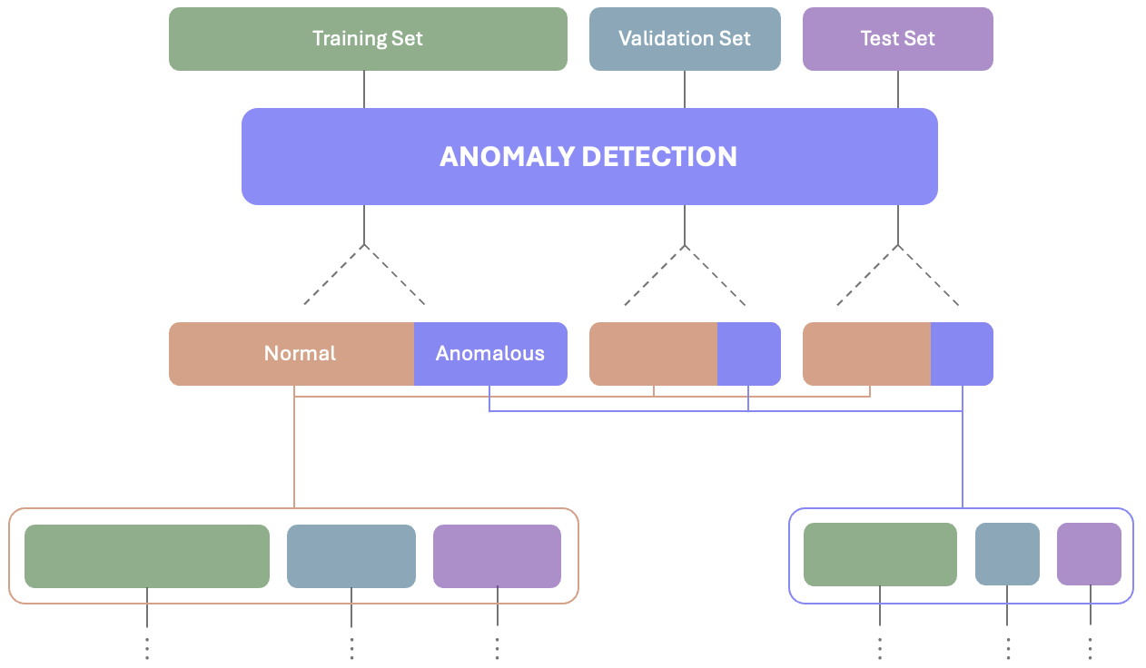
Iteration 1
Iteration 2

Slide 48
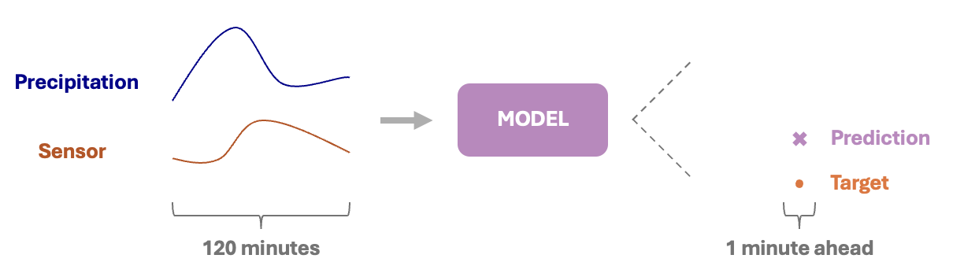
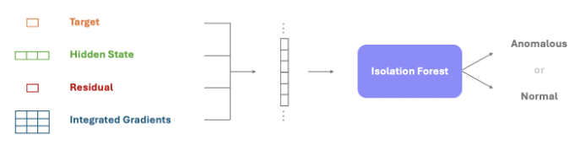
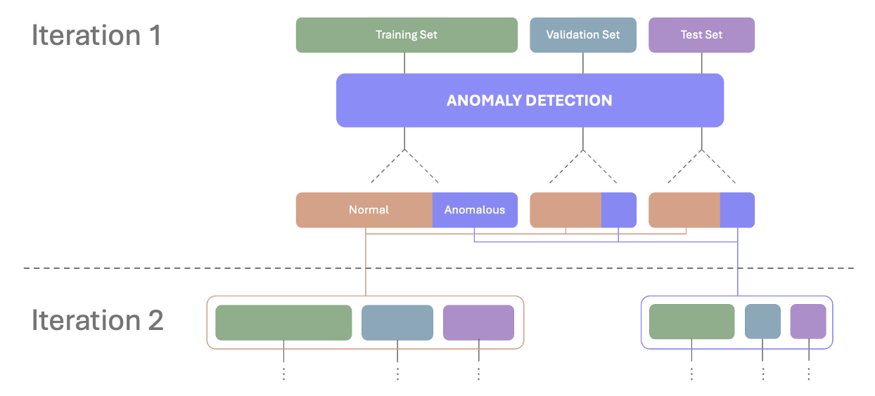
RQ1: Optimal Modelling
RQ2: Synthetic Anomalies
RQ3: Anomaly Detection
RQ4: Targeted Iterative Refinement

Slide 49
RQ2: Synthetic Anomalies
RQ3: Anomaly Detection
RQ4: Targeted Iterative Refinement

Slide 50
Dataset
Split
Training Set
Validation Set
Test Set
Scaling
Rain Gauge 5425
G71F04R_Level2
Input (2 variables, 120 minutes)
Target(1 minute)

Slide 51
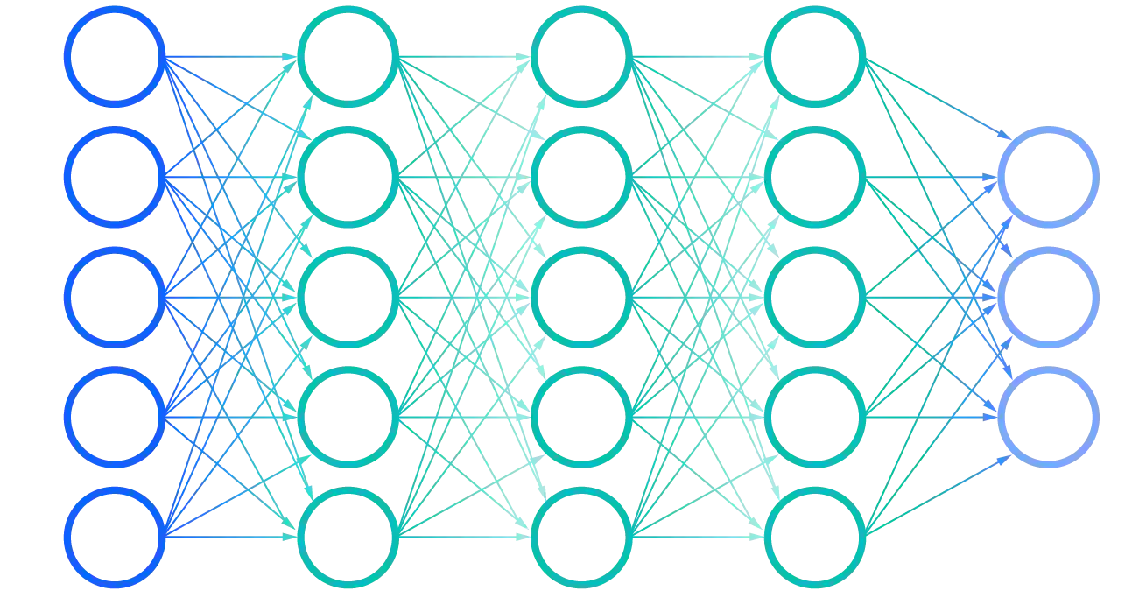

Slide 52
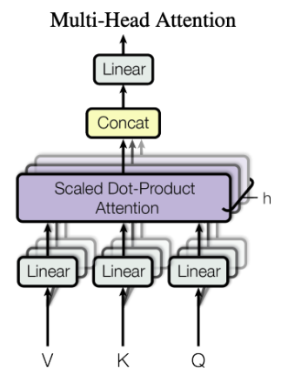
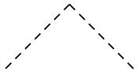
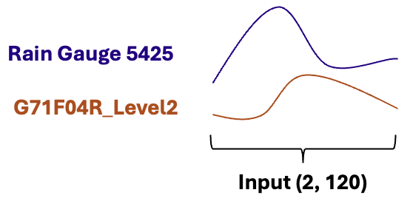
(1)
Final Layer
Hidden State
(Hidden Size, 120)
Heads
(Number of Heads)
Transformer Encoder Layer
(1 Layer)
W^{V} W^{K} W^{Q}
(Hidden Size, 120)
Embedding Layer
Rain Gauge 5425
G71F04R_Level2
Input (2, 120)

